Slide 1


Mª Carmen Obrero Tapias
August 21, 2025

Slide 2

Outline
Executive Summary
Introduction
Methodology
Insights drawn from EDA
Launch Sites Proximities Analysis
Dashboard with Plotly Dash
Predictive Analysis (Classification)
Conclusions
Appendix

Slide 3
Executive Summary
Brief context:
We analyzed SpaceX launches to identify factors associated with successful first-stage landings and to build a classification model that predicts them.
Summary of methodologies:
Data acquisition: SpaceX API + web scraping (Wikipedia)
Data cleaning and preparation (wrangling): category standardization, target variable creation, and one-hot encoding.
EDA: tables and charts
Interactive analytics: map with Folium and dashboard with Plotly Dash
Prediction: multiple classifiers; comparison by accuracy and confusion matrix for the best model
Summary of all results:
Overall success ≈ 67%
By site, KSC LC-39A ≈ 77% (best performance)
Upward success trend (≈ 90% in 2019)
Payloads 3-6 t show higher success than >6 t in this dataset
Implications:
Launch site and payload range have a practical impact on recovery probability; orbit also provides signal (mind the sample size)

Slide 4
Introduction
Project background and context:
SpaceX aims to maximize first-stage recovery to reduce costs. Using historical launch data, we investigate which variables (launch site, payload mass, orbit, booster version, flight number, etc.) influence success and how results have changed over time.
Objective:
Identify the factors associated with a successful first-stage landing and evaluate a classification model to predict it
Research questions:
Which factors are associated with a higher probability of a successful first-stage landing?
How do payload mass (kg) and orbit affect the outcome?
Are there differences by launch site?
How has the success rate evolved overtime?
Can we predict success with a reliable classification model?
Target variable definition
Successful first-stage landing (1 = success, 0 = failure).

Slide 5

Section 1

Slide 6
Methodology
Methodology Overview
Data collection methodology:
SpaceX REST API (v4) + Wikipedia web scraping (Python: requests, pandas, BeautifulSoup).
Data wrangling & processing:
Standardized categories; engineered target Class (1 = successful landing if Outcome starts with “True”, else 0); one-hot encoding for categorical features; basic handling of missing values
EDA (SQL & visualization):
SQLite queries for success rates by site / orbit and yearly trend. Charts for success by launch site, payload bands, and temporal trend.
Interactive visual analytics:
Folium map of launch sites; Plotly Dash dashboard with filters (site, payload)
Predictive analysis:
Built and compared classifiers (SVM, Decision Tree, Logistic Regression, KNN); hyperparameter tuning via GridSearchCV; evaluation with accuracy, confusion matrix, and classification report.

Slide 7
Data Collection
Source (modeling): SpaceX REST API (v4)
Period & scope: Falcon 9 (2010 – 2020); 90 records → dataset_part1/2/3.csv
Tools: Python (requests, pandas)
Key fields: Date, FlightNumber, LaunchSite, Orbit, PayloadMass, Outcome
Separate artifact: Wikipedia scraped table (121 rows) – not merged (kept for exploration/demonstration)
Reproducibility: Code & data available – modeling dataset (SpaceX API, 90 records): dataset_part_1.csv, dataset_part_2.csv, dataset_part_3.csv; separate artifact (scraped, 121 rows): spacex_web_scraped.csv. Notebooks/Dashboard: GitHub

Slide 8
Data Collection – SpaceX API
SpaceX REST calls
GET /v4/launches/past → response.json → pd.json_normalize()
Fields kept: rocket, payloads, launchpad, cores, flight_number, date_utc
Filter: 1 core & 1 payload per launch; parse date_utc → date
Time window: date ≤ 2020-11-13
Per-record enrichment
GET /V4/rockets/{id} → BoosterVersion
GET /V4/launchpads/{id} → LaunchSite, Latitude, Longitude
GET /V4/payloads/{id} → PayloadMass, Orbit
GET /V4/cores/{id} → Block, ReusedCount, Serial, Flights, GridFins, Reused, Legs, LandingPad, Outcome
Final steps
Keep Falcon 9 only; fill PayloadMass with mean
Reset FlightNumber = 1..N
Export: dataset_part_1.csv (90 rows)
Notebook (GitHub): GitHub
Define helper functions
getBoosterVersion
Request launch data from the SpaceX API
Get the initial response
Decode the response content as JSON
Create a new DataFrame
Run the helper functions to enrich (rocket, payload, launchpad, cores)
getLaunchSite
getPayloadData
getCoreData
Keep the columns we will use
Filter to "simple" launches
Normalize the date
Restrict the time range
Filter the DataFrame to include only Falcon 9 launches
Renumber FlightNumber as 1..N after filtering to Falcon 9
Replace missing values in PayloadMass with the mean
Export: dataset_part_1.csv (90 rows)

Slide 9
Data Collection - Scraping
Static URL (Wikipedia revision):
https://en.wikipedia.org/w/index.php?title=List_of_Falcon_9_and_Falcon_Heavy_launches&oldid=1027686922
Request & parse:
resp = requests.get(static_url, timeout=15); resp.raise_for_status() → response = resp.content
soup = BeautifulSoup(response, ‘html.parser’)
Locate tables:
soup.find_all(‘table’, ‘wikitable plainrowheaders collapsible’)
Row parsing (loop):
Use the header cell th for Flight No.; parse other cells with helpers
Build & export:
Append values into launch_dict → pd.DataFrame(launch_dict) → df.to_csv(‘spacex_web_scraped.csv’, index=False) (121 rows)
Define helper functions
date_time
booster_version
Fetch HTML from the given URL
Use requests.get(...) to obtain a response
Extract column names from the table header
Build a DataFrame from the parsed HTML
Build a dictionary using the helper functions
landing_status
get_mass
extract_column_from_header
Create a BeautifulSoup object
Create a DataFrame from that dictionary
Export to CSV: spacex_web_scraped.csv (121 rows)
Notebook (GitHub): GitHub

Slide 10
Data Wrangling
Input: dataset_part_1.csv (90 rows)
Missing values: df.isnull().sum() / len(df) * 100
Types: df.types() (identify numerical vs categorical)
Launch counts (by site): df[‘LaunchSite’].value_counts()
Orbit x Outcome (counts & %): df.loc[df[‘Orbit’] != ‘GTO’, ‘Orbit’].value_counts() → df.loc[df[‘Orbit’] != ‘GTO’, ‘Orbit’].value_counts(normalize=True)
Enumerate landing outcomes: df[‘Outcome’].value_counts() → define bad_outcomes
Create target: build landing_class (0 if outcome = bad_outcomes else 1) df[‘Class’] = landing_class
Export: df.to_csv(‘dataset_part_2.csv’, index=False) (90 rows)
Notebook (GitHub URL): GitHub
Data analysis
Identify and compute % of missing values
Calculations
Launches by site
Create new column
From Outcome, define bad_outcomes
Identify numeric vs categorical columns
Orbit counts & percentages (excluding GTO for these tables)
Mission outcomes by orbit: counts & percentages
Build target Class
Compute success rate using Class
Export: dataset_part_2.csv

Slide 11
EDA with Data Visualization 1
In this section we explore the correlations between these pairs:
Flight Number vs Payload Mass (sns.catplot, hue=Class)
Why: quick view of how payload mass and launch sequence relate to landing outcome
Flight Number vs Launch Site (sns.catplot / strip, hue=Class)
Why: compare success patterns across sites along the flight sequence
Payload Mass vs Launch Site (sns.scatterplot, hue=Class)
Why: check whether heavier payloads behave differently by launch site
Success rate by Orbit (sns.barplot of mean(Class) * 100 by Orbit)
Why: categories bar chart is appropriate to compare success proportions
Flight Number vs Orbit (sns.scatterplot, hue=Class)
Why: inspect outcome variation across orbits over time (proxied by flight number)

Slide 12
EDA with Data Visualization 2
Payload Mass vs Orbit (sns.scatterplot, hue=Class)
Why: visualize the interplay between mass and orbit type on success
Yearly success trend (sns.lineplot of mean(Class) * 100 by year from Date)
Why: reveal temporal trend in landing success
Also we did feature engineering in this lab
Input: dataset_part_2.csv
Categorical encoding: for categorical columns → features_one_hot = pd.get_dummies(features, columns=[‘Orbit’, ‘LaunchSite’, ‘LandingPad’, ‘Serial’], dtype=int)
Cast to float64 DataFrame features_one_hot
Output: dataset_part_3.csv (90 rows, 80 columns)
Notebook (GitHub URL): GitHub

Slide 13
EDA with SQL - Summary
Setup: %sql sqlite:///my_data1.db; DROP TABLE IF EXISTS SPACEXTABLE; → CREATE TABLE SPACEXTABLE AS SELECT * FROM SPACEXTBL WHERE Date IS NOT NULL;
Inventory & Sample: DISTINCT Launch_Site; preview rows for Launch_Site LIKE ‘CCA%’ (LIMIT 5)
Aggregations: SUM(PAYLOAD_MASS__KG_) for ‘NASA (CRS)’; AVG(PAYLOAD_MASS__KG_) for ‘F9 v1.1%’
Milestone: earliest ground-pad success MIN(date(Date)) where Landing_Outcome = ‘Success (ground pad)’
Conditional filter: booster versions with drone-ship success and 4-6 t payload
Outcomes:
overall success vs failure counts (CASE WHEN…);
landing outcome distribution ranked by count
Extremes: booster version at maximum payload mass (subquery on MAX)
Time slice: 2015 failed drone-ship landings by month (substr(Date, 6, 2))
Notebook (GitHub URL): GitHub

Slide 14
Build an Interactive Map with Folium
Base map:
folium.Map(location=[29.55968, -95.08310]) – centered initially at NASA JSC.
Objects added & why:
Circle (folium.Circle) at NASA JSC + Popoup – highlight the reference location and label it
Text marker (folium.Marker with DivIcon) at NASA JSC – readable site name on the map
MarkerCluster (folium.plugins.MarkerCluster) – group many launch markers to keep the map clear
Launch markers (folium.Marker with folium.Icon) – one per launch row; icon color from class (green success / red failure) for instant outcome reading; popup shows Launch Site – Success/Failure
Mouse position (folium.plugins.MousePosition) – live lat/long under the cursor for inspection
Small site dots (folium.CircleMarker) – precise location of each launch site
Polylines (folium.PolyLine) from each launch site to nearby targets – train, city, highway, coast – to visualize proximity
Distance labels (folium.Marker with DivIcon) at each target – show distance in km; popup with target label and coordinates
Notebook (GitHub URL): GitHub

Slide 15
Build a Dashboard with Plotly Dash – Summary 1
Plots
Success Pie (px.pie)
All sites: total successful launches by launch site (sum(class) by Launch Site)
Selected site: success vs. failure counts for that site
Payload vs. Success Scatter (px.scatter)
x: Payload Mass (kg) / y: class (0/1)
color: Booster Version Category
hover: Launch Site, Payload Mass (kg)
Interactions
Dropdown (site-dropdown): switches between All Sites (default) and a specific site for both charts
RangeSlider (payload-slider, 0-10,000 kg): filters the scatter plot by payload range

Slide 16
Build a Dashboard with Plotly Dash – Summary 2
Why these plots & interactions
Pie: quickly compare success distribution across sites, or success vs. failure within one site
Scatter + slider: explore the relationship between payload mass and landing outcome, and see how it varies by booster version and site; the slider focuses the analysis on relevant mass ranges.
Dash app (GitHub URL): GitHub

Slide 17
Predictive Analysis (Classification) 1
Data & split
Input features: dataset_part_3.csv (90x80); target Y = Class
Standardize features: StandardScaler.fit_transform(X) → X_scaled
Split: train_test_split(X_scaled, Y, test_size=0.2, random_state=2, stratify=Y)
Define helper functions
plot_confusion_matrix
Feature preparation
Create variables X and Y
Modeling & evaluation
Decision Tree Classifier
Standardize X
Split data into train/test
Check class balance in train/test
LogisticRegression
Build the model with GridSearchCV
Evaluate accuracy, confusión matrix, and classification_report
SVM (SVC)
KNeighbors Classifier
Select the best model (highest test accuracy)

Slide 18
Predictive Analysis (Classification) 2
Models trained (each with 10-fold CV via GridSearchCV, scoring=‘accuracy’)
Logistic Regression (LogisticRegression): grid C=[0.01, 0.1, 1], penalty=‘l2’, solver=‘lbfgs’
SVM (SVC): grids over kernel = {linear, rbf, poly, sigmoid}, C & gamma on logspace
Decision Tree (DecisionTreeClassifier): grid on criterion, splitter, max_depth, max_features, min_samples-leaf, min_samples_split
KNN (KNeighborsClassifier): grid on n_neighbors, algorithm, p
Evaluation & model selection
For each best-CV model: compute test accuracy (.score(X_test, Y_test))
Plot confusion matrix(plot_confusion_matrix) and print classification report (precision, recall, f1, balanced accuracy)
Select best-performing model = highest test accuracy
Notebook (GitHub URL): GitHub

Slide 19
Results – Exploratory data analysis (EDA)
Overall landing success (Class=1): ~66.7% (from dataset_part_2.csv)
By launch site: KSC LC-39A ~77%, VAFB SLC-4E ~77%, CCAFS SLC-40 ~60% (success rate)
Yearly trend: upward improvement peaking at ~90% in 2019
By payload band: ≤1 t ~75%, 1-3 t ~68%, 3-6 t ~62%, 6-10 t ~65% (success rate)
By orbit (note small-n effects): several orbits show 100% in this sample (e.g., SSO, ES-L1, GEO, HEO), while GTO ~52%, ISS ~62%, LEO ~71%
These figures come from the Lab 3 / 5 datasets (dataset_part_2.csv) and match the visuals summarized in Slide 11.

Slide 20
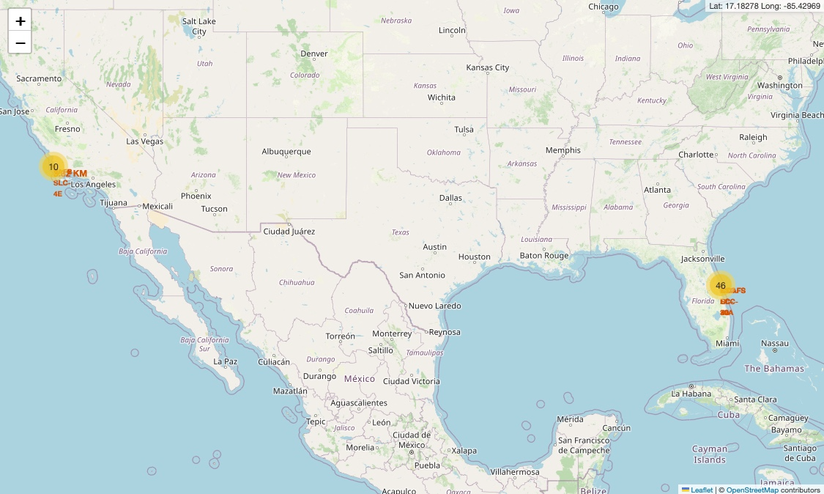
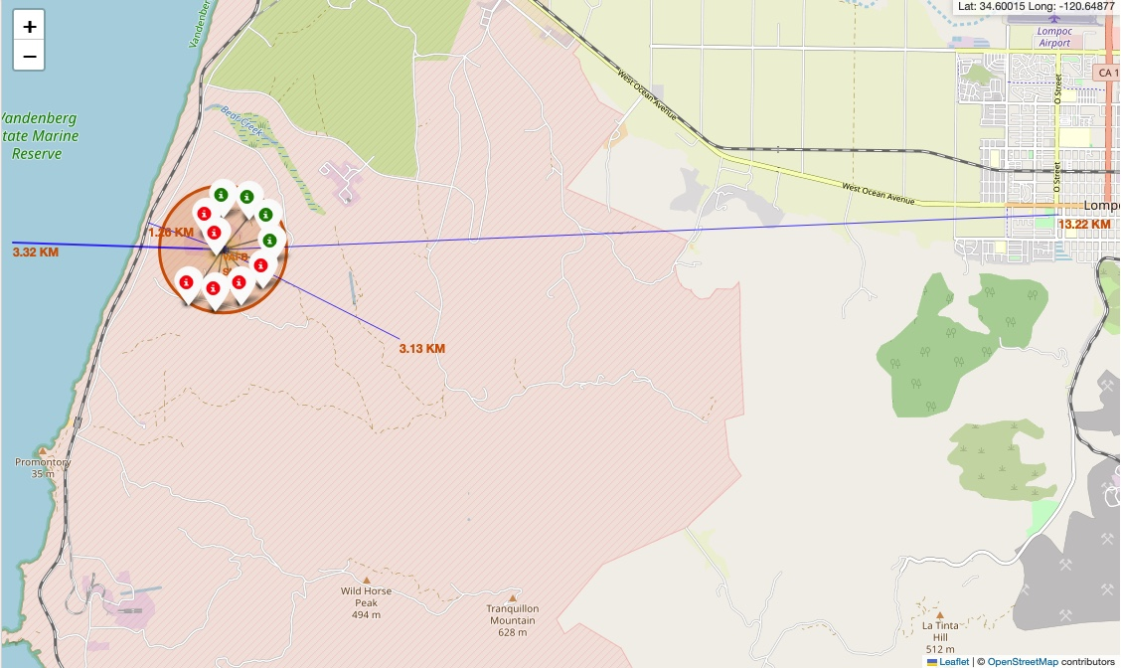
Results – Interactive analytics 1
Folium map (Lab 6)
Map centered near NASA JSC with site markers (Marker, CircleMarker).
Polylines to nearest city/train/highway/coast, and distance labels

Slide 21
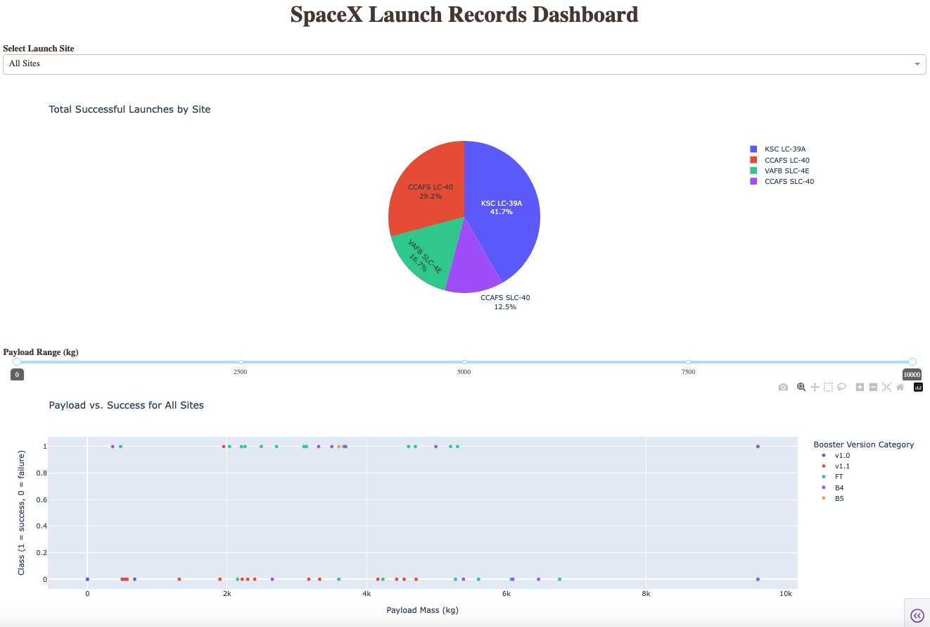
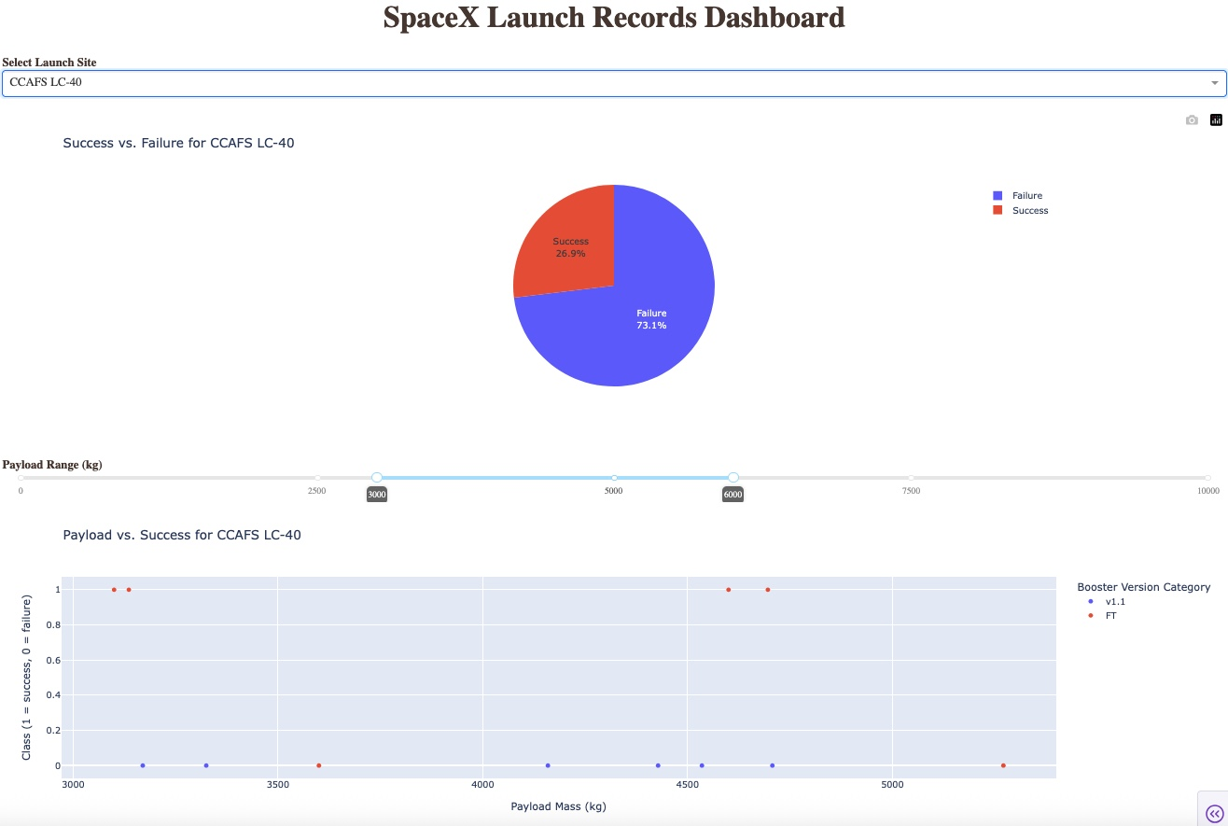
Results – Interactive analytics 2
Dash dashboard (Dash app (Lab))
Success pie (All Sites) and success vs. failure (Selected Site)
Payload vs. Success scatter filtered with the payload slider and site dropdown
Launch Site: All Sites Payload Range (kg): 0 – 10 t
Launch Site: CCAFS LC-40 Payload Range (kg): 3 – 6 t

Slide 22
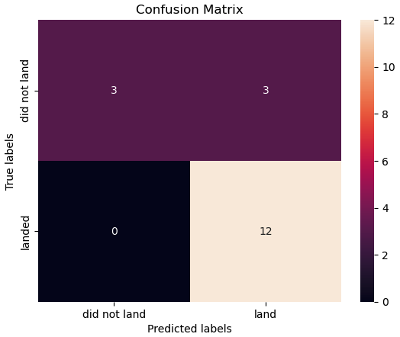
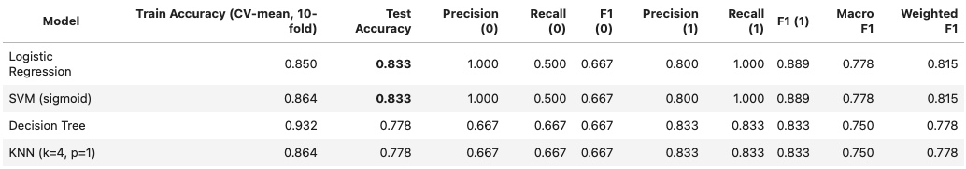
Results – Predictive analysis (Classification)
Process: standardized features → train/test split (80/20 = 72/18, stratified) → GridSearchCV (cv=10, scoring=‘accuracy’) on Logistic Regression, SVM (SVC), Decision Tree, KNN → evaluate on test
What to report:
Best model(s): Logistic Regression and SVM (sigmoid) – both Test Accuracy = 0.833 and with same confusion matrix (see images)
Takeaway: LR and SVM (sigmoid) provide the highest test accuracy among the four; performance aligns with patterns observed in EDA (site, payload, orbit).
Notebooks and Dash app (GitHub URL): GitHub

Slide 23

Section 2

Slide 24
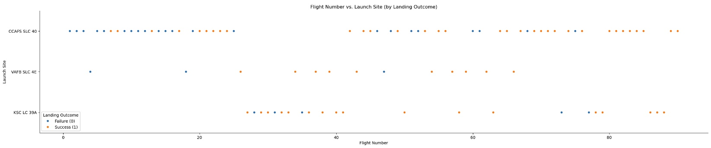
Flight Number vs. Launch Site
Chart spec
Catplot/strip plot: x = FlightNumber, y = LaunchSite, hue = Class (1 = successful landing, 0 = failed landing)
How to read it: each dot = a launch; color encodes the landing outcome
Key patterns:
Later flights skew to success (more Class=1 at higher FlightNumber)
LC-39A concentrates successes; SLC-40 is mixed; SLC-4E is sparse (small-n)
Context: sites were activated at different times, which partly explains the “later = better” pattern.

Slide 25
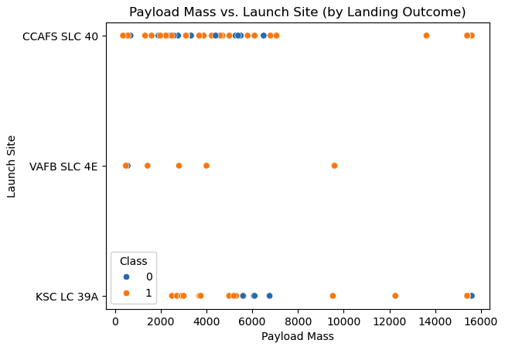
Payload vs. Launch Site
Chart spec
Scatter/strip plot: x = Payload Mass (kg), y = LaunchSite, hue = Class (1 = successful landing, 0 = failed landing)
How to read it:
Each dot = a launch; color encodes the landing outcome
Key patterns:
No strict monotonic effect: successes and failures appear across the payload range (mid-range masses look more favorable ≈3-6 t)
By site: LC-39A clusters many successes; SLC-40 shows a more mixed pattern; SLC-4E is sparse (small-n)
A few high-payload outliers do not systematically change the outcome

Slide 26
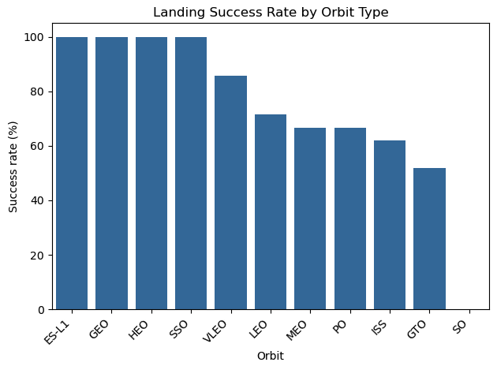
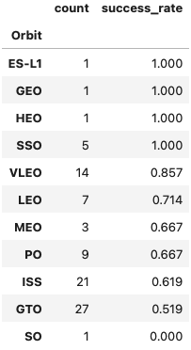
Success Rate vs. Orbit Type
Chart spec:
Bar chart of mean (Class) * 100 by Orbit (success rate in %)
Order bars descending
How to read it:
Each bar height = success rate (%) for that orbit; label shows the %
Key patterns:
Highest: SSO 100% (count=5); VLEO 85.7% (count=14); LEO 71.4% (count=7)
Mid: MEO 66.7% (count=3); PO 66.7% (count=9); ISS 61.9% (count=21)
Lower: GTO 51.9% (count=27) — largest sample
Edge cases (small-n): ES-L1 100% (count=1), GEO 100% (count=1), HEO 100% (count=1), SO 0% (count=1) → interpret with caution.

Slide 27
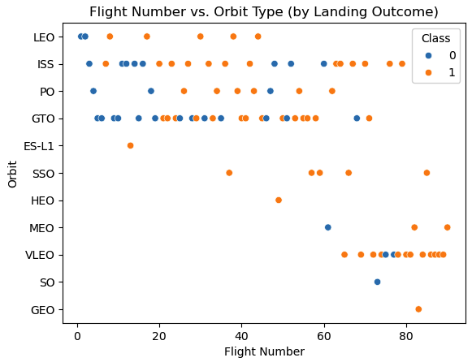
Flight Number vs. Orbit Type
Chart spec:
Catplot/strip: x = FlightNumber, y = Orbit, hue = Class ( 1 = successful landing, 0 = failed landing)
How to read it:
Each dot = a launch; color encodes the landing outcome
Key patterns:
Later flights skew to success across orbits
GTO: success improves from early → late flights
ISS: modest improvement
PO: roughly stable across periods
VLEO: appears only in later flights; LEO appears only in earlier flights – reflects when those orbits were flown
Small-n orbits (e.g., SSO, GEO, HEO, ES-L1, SO) show isolated points → interpret cautiously

Slide 28
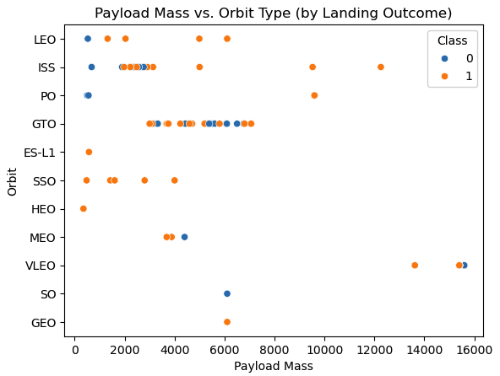
Payload vs. Orbit Type
Chart spec:
Catplot/strip: x = Payload Mass (kg), y = Orbit, hue = Class (1 = successful landing, 0 = failed landing)
How to read it:
Each dot = one launch; color encodes the landing outcome
Key patterns:
GTO: success declines with heavier payloads
ISS / LEO: mid range payloads (≈ 1-6 t) show moderate hight success
VLEO: only > 10 t payloads in this sample, with high success
Small-n orbits (e.g., SSO, GEO, HEO, ES-L1, SO) → interpret cautiously
Overall: GTO shows more failures at higher masses, while mid-range payloads are comparatively favorable in several orbits

Slide 29
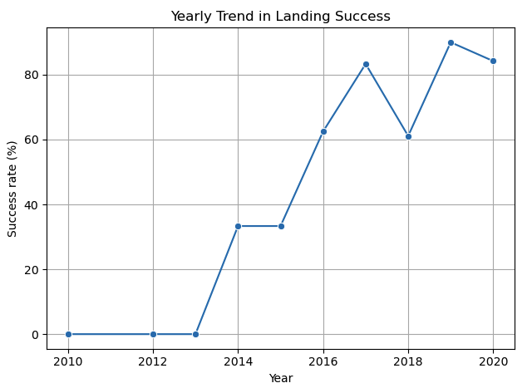
Launch Success Yearly Trend
Chart spec:
Line chart of mean(Class) * 100 by Year (success rate, %), with point markers.
How to read it:
The line shows the annual landing success rate.
Key patterns
2010-2013: 0% success
2014-2016: steady improvement to ≈ 62% in 2016
2017: ≈ 82%
2018: dip to ≈ 60%
2019: peak ≈ 90%
2020: remains high at ≈ 84%
Overall: the yearly landing success shows a clear upward trend (peaking in 2019 and staying high in 2020)

Slide 30
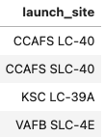
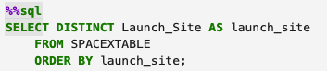
All Launch Site Names (SQL)
Query:
Result (as shown in the image):
CCAFS LC-40 / CCAFS SLC-40 (Cape Canaveral LC-40 (Florida))
KSC LC-39A (Kennedy LC-39A (Florida))
VAFB SLC-4E (Vandenberg SLC-4E (California))
Brief explanation:
The query returns four distinct labels from Launch_Site
CCAFS LC-40 and CCAFS SLC-40 are two label variants for the same Cape Canaveral pad (SLC-40). In this project we did not normalize them, so the dashboard shows all four labels
Implication: site-level counts/plots may split Cape Canaveral launches across the two labels

Slide 31
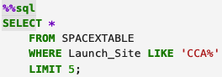
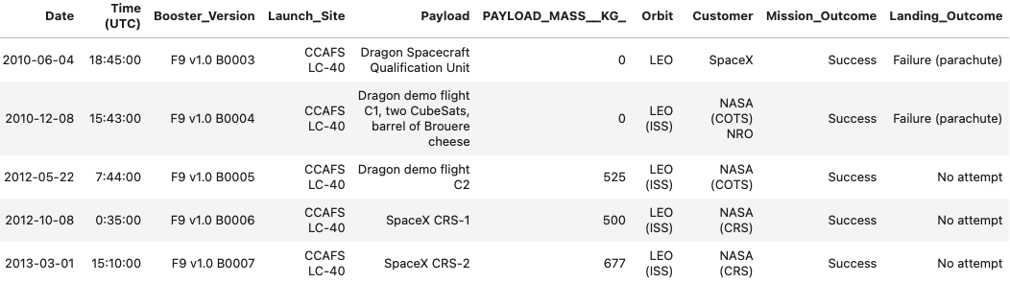
Launch Site Names Begin with 'CCA’ (SQL)
Query
Result:
Rows where Launch_Site starts with ‘CCA’ (Cape Canaveral labels)
In this sample, the first 5 matches are all CCAFS LC-40 (2010-2013), with early missions whose Landing_Outcome is Failure (parachute) or No attempt
Brief explanation:
LIKE ‘CCA%’ applies a prefix filter (% = any trailing characters)
LIMIT 5 returns only five matching rows
We use this filter to quickly subset Cape Canaveral launches for inspection

Slide 32
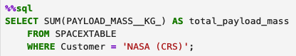
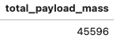
Total Payload Mass (SQL)
Query:
Result:
total_payload_mass = 45,596 kg
Brief explanation:
We aggregate PAYLOAD_MASS__KG_ for all rows where Customer = ‘NASA (CRS)’
SUM returns the cumulative payload mass (in kg) for CRS missions present in this table (project time window)
Note: SUM ignores NULLs; rows with 0 kg are included as zero

Slide 33
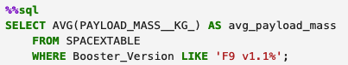
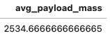
Average Payload Mass by F9 v1.1 (SQL)
Query:
Result:
avg_payload_mass = 2,534.67 kg (shown as 2534.6666…)
Brief explanation:
AVG computes the mean of PAYLOAD_MASS__KG_ for rows where Booster_Version starts with ’F9 v1.1’ (the % is the wildcard for any suffix/sub-variant)
The average is in kilograms; AVG ignores NULLs, while 0 kg rows (if any) are included as zero
The displayed decimals come from the exact arithmetic; for reporting we round to 2,534.67 kg

Slide 34
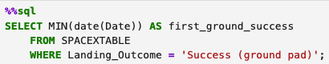
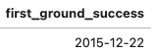
First Successful Ground Landing Date (SQL)
Query:
Result:
First_ground_success = 2015-12-22
Brief explanation:
Filters rows to ground-pad landing successes and returns the earliest calendar date
date(Date) normalizes the string to YYYY-MM-DD before applying MIN
The value reflects the first such event recorded in this table (i.e., within the dataset’s time window)

Slide 35
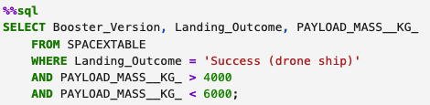
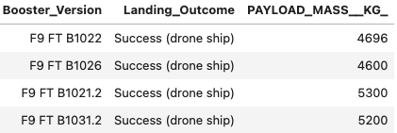
Successful Drone Ship Landing with Payload between 4000 and 6000 (SQL)
Query:
Result:
F9 FT B1022 — Success (drone ship) — 4696 kg
F9 FT B1026 — Success (drone ship) — 4600 kg
F9 FT B1021.2 — Success (drone ship) — 5300 kg
F9 FT B1031.2 — Success (drone ship) — 5200 kg
Brief explanation:
Filters successful drone-ship landings with payload mass strictly between 4,000 and 6,000 kg (> and < are exclusive)
Returns 4 rows in this dataset; all are Falcon 9 FT boosters in that mass band.
If you needed an inclusive range, use BETWEEN 4000 AND 6000 or >= 4000 AND <= 6000.

Slide 36
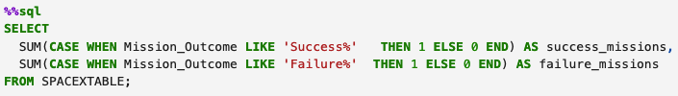
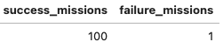
Total Number of Successful and Failure Mission Outcomes (SQL)
Query:
Results:
success_missions = 100
failure_missions = 1
Brief explanation:
We count rows where Mission_Outcome starts with ‘Success’ or ‘Failure’ (% is the wildcard), so labels like Success (drone ship) are included
Other outcome categories (e.g., Partial Failure, Prelaunch Failure, No attempt) are excluded by design – this slide reports only explicit successes and failures.
These are counts (not percentages)

Slide 37
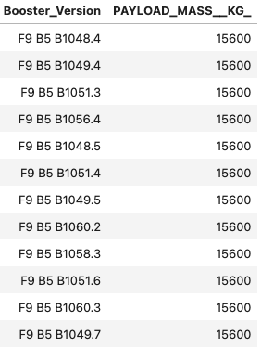
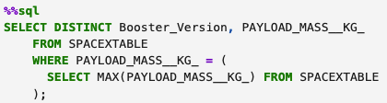
Boosters Carried Maximum Payload (SQL)
Query:
Results:
All returned rows have PAYLOAD_MASS__KG_ = 15,600 kg
Boosters include several Falcon 9 Block 5 units (see image)
Brief explanation:
The subquery gets the global maximum payload mass in the table
The outer query returns every booster whose recorded payload mass equals that maximum; DISTINCT prevents duplicate booster/payload pairs
Several boosters appear because multiple missions share the same top mass (15,600 kg) in this dataset

Slide 38
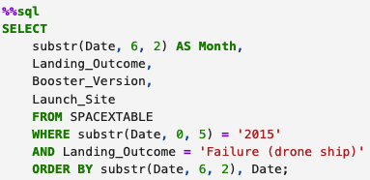
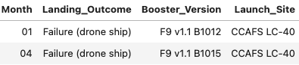
2015 Launch Records (SQL)
Query:
Results:
See image
Brief explanation:
Filters to year 2015 (substr(Date, 0, 5) = ‘2015’) and to drone-ship landing failures only
Extracts the month as substr(Date, 6, 2) (MM) and orders chronologically by month (then date)
In this dataset, there are two matching records, both at Cape Canaveral LC-40 with Falcon 9 v1.1 boosters

Slide 39
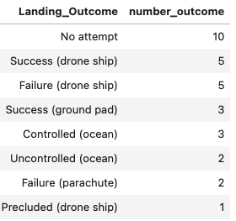
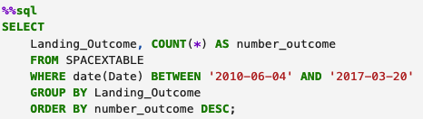
Rank Landing Outcomes Between 2010-06-04 and 2017-03-20 (SQL)
Query:
Results:
See ranked table (right)
Brief explanation:
date(Date) casts timestamps to a date (YYYY-MM-DD) and BETWEEN is inclusive of both endpoints
We aggregate counts by Landing_Outcome and rank them with ORDER BY number_outcome DESC
Counts reflect only this time window (early Falcon 9 era), hence the high number of No attempt outcomes

Slide 40

Section 3

Slide 41
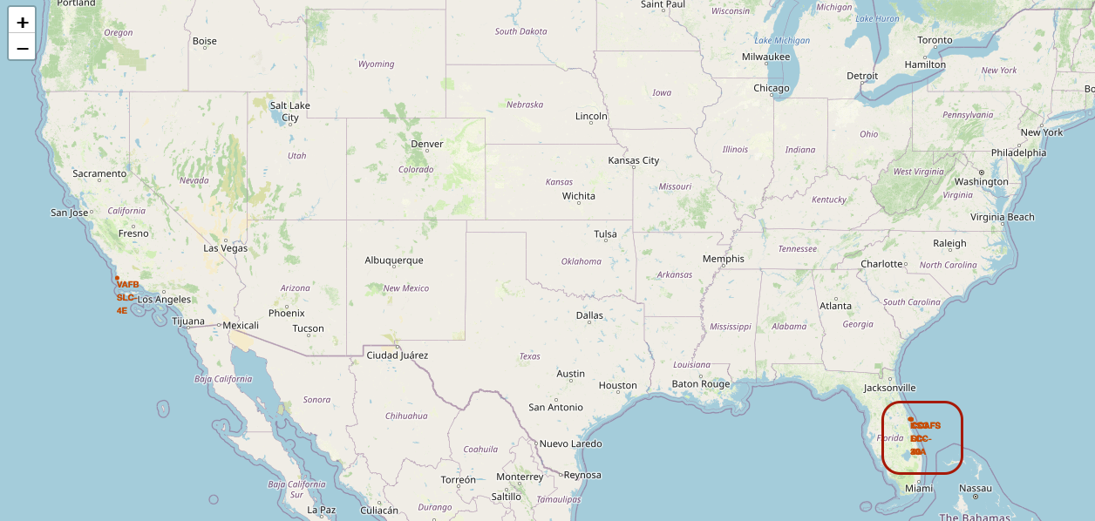
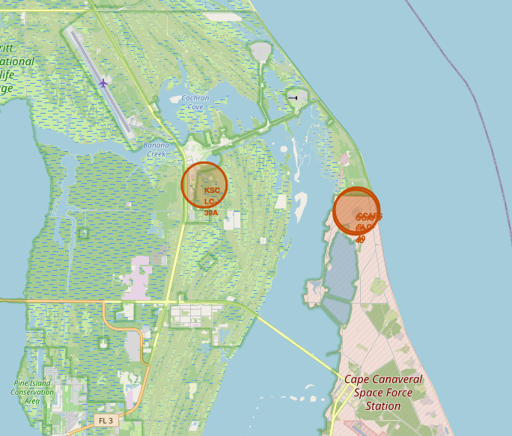
SpaceX Launch Sites – Global Map (Folium)
Markers show the four launch sites used in this project:
KSC LC-39A, CCAFS LC-40, CCAFS SLC-40 (Cape Canaveral, Florida)
VAFB SLC-4E (Vandenberg, California)
At global zoom the three Florida pads are nearly co-located and overlap (task1 uses no MarkerCluster). The inset zoom separates them and shows their exact placement on Cape Canaveral.
All sites are coastal, consistent with range-safety corridors and downrange recovery operations (drone ship / ground pad)
In the interactive map, clicking a marker shows the site name.

Slide 42
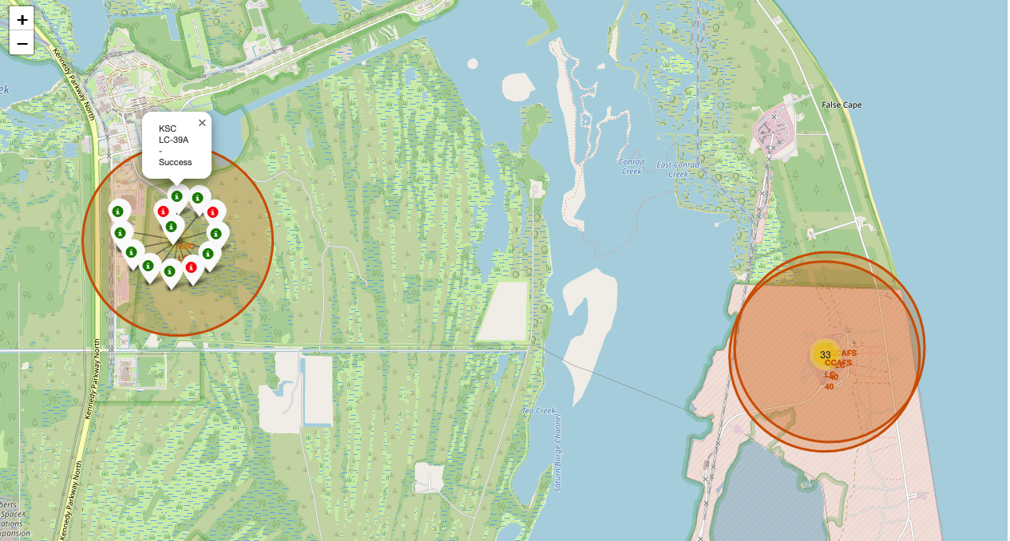
Launch Outcomes at Cape Canaveral– Color-coded Map (Folium)
What the screenshot shows:
Points = launches; color = outcome (green = success, Class=1; red = failure, Class=0). Clicking a marker shows site & outcome
Left: launches around KSC LC-39A (mostly green)
Right: a cluster over CCAFS LC-40 / CCAFS SLC-40; zooming reveals the individual colored pins
Orange site circles mark the pad areas: all pads are coastal, consistent with range-safety corridors and downrange recovery
Findings in this view:
Success dominates at Cape Canaveral (green clearly outnumbers red)
LC-40 appears most active in this sample; LC-39A shows a high success rate with occasional failures
Scope note:
This crop focuses on Florida; VAFB SLC-4E (not shown here) has fewer launches in this period and also shows a majority of successes
Overall:
Greens dominate at LC-39A; the Cape pads show mixed early results; Vandenberg has fewer, mixed records

Slide 43
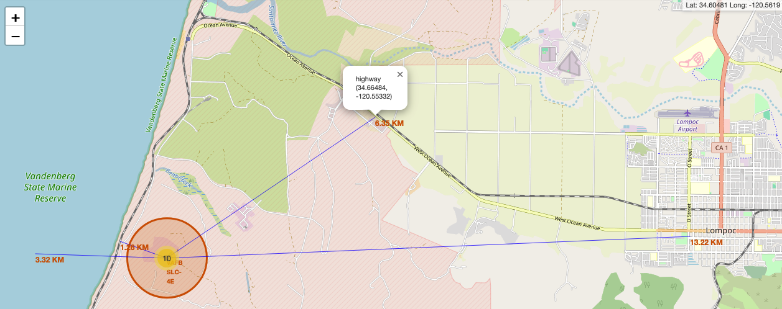
Vandenberg SLC-4E – Distances to Coast, Train, Highway & city (km) (Folium)
What the screenshot shows:
Orange circle = SLC-4E launch pad
Blue lines with km labels (straight-line from the pad) to:
Rail line: 1.26 km (west)
Coastline: ≈ 3.32 km (west)
Highway (CA-1 / West Ocean Ave corridor): ≈ 6.35 km (NE)
Lompoc city center (≈ 13.22 km) (east)
Key findings:
Very close to rail (≈1.3 km) and coast (≈3.3 km) → good logistics and over-ocean trajectories/downrange recovery.
CA-1 access (≈6.3 km) provides reliable ground transport
The ~13 km standoff to Lompoc provides a reasonable safety buffer from populated areas

Slide 44

Section 4

Slide 45
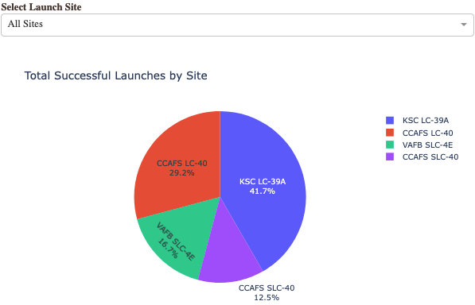
Launch Success Count by Site (All Sites – Dash Pie Chart)
What this shows: Distribution of successful launches (sum of Class == 1) grouped by launch site
How to read it: Slice size = number of successes for that site (not a success rate); colors match the legend
Key takeaways:
KSC LC-39A: ~41.7% — largest slice, CCAFS LC-40: ~29.2% — second largest, VAFB SLC-4E ~16.7%, CCAFS SLC-40 ~12.5% — smallest slice
Overall, Cape Canaveral dominates: LC-39A + LC-40 + SLC-40 ≈ 83% of all successes in this dataset (LC-40 and SLC-40 are shown separately because that’s how the dataset labels them)
Note:
This chart shows count, not success rates; proportions reflect how many successful missions each site has, not the percentage success at that site
Dropdown = All Sites; the pie summarizes successes across all sites

Slide 46
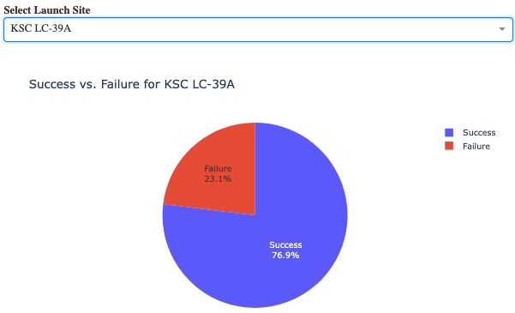
Site with Highest Success Ratio – KSC LC-39A (Dash Pie Chart)
What this shows:
Pie chart of Success vs. Failure at the selected site (dropdown set to KSC LC-39A)
Values are ratios within this site (not counts across sites)
How to read it:
Blue = Success (Class=1), Red = Failure (Class=0)
Slice labels show each class’s percentage of LC-39A launches
Key finding
KSC LC-39A ≈ 76.9% success vs. 23.1% failure — the highest success ratio among sites in this dataset (VAFB SLC-4E is similar but with fewer launches, so interpret ties cautiously)
Note:
Changing the dropdown recomputes the ratios; keep it on KSC LC-39A to match this slide

Slide 47
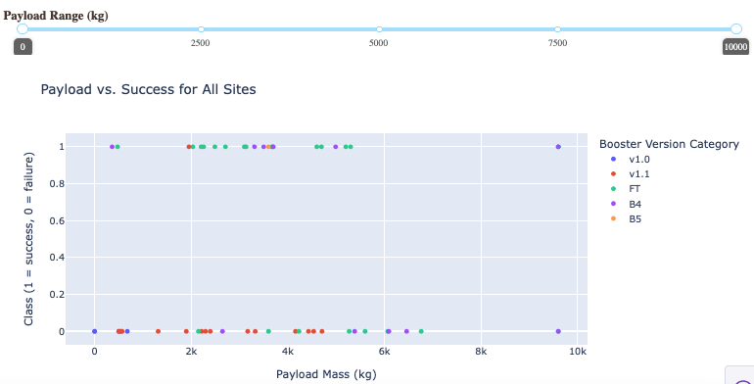
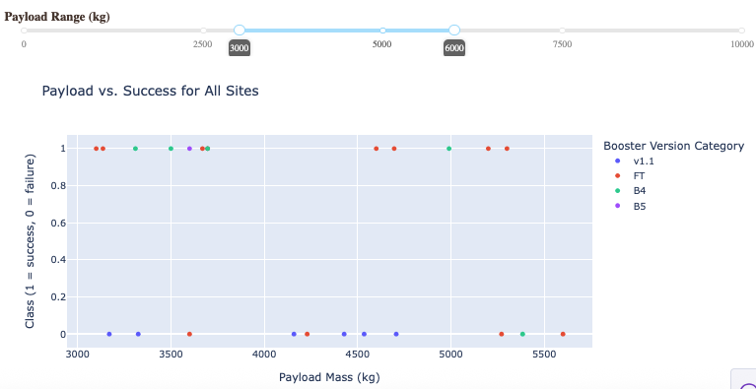
Payload vs. Landing Outcome by Payload Range (Dash Scatter)
What this shows: Scatter of all sites — x = Payload (kg), y = Class (1=success, 0=failure), color = Booster version Category. The range slider filters the payload band.
Screenshots: Left 0–10,000 kg (full range). Right = 3,000–6,000 kg (focused mid-range)
Insights: Success points cluster in the ~2–6 t band; very low and very high payloads show a more mixed outcome. Filtering to 3–6 t reveals a clear majority of successes.
Booster note: Later boosters (FT, B4, B5) dominate among successes; earlier v1.0/v1.1 show more failures at lower masses
Caution: This is outcome distribution, not a normalized success rate by payload or by site

Slide 48

Section 5

Slide 49
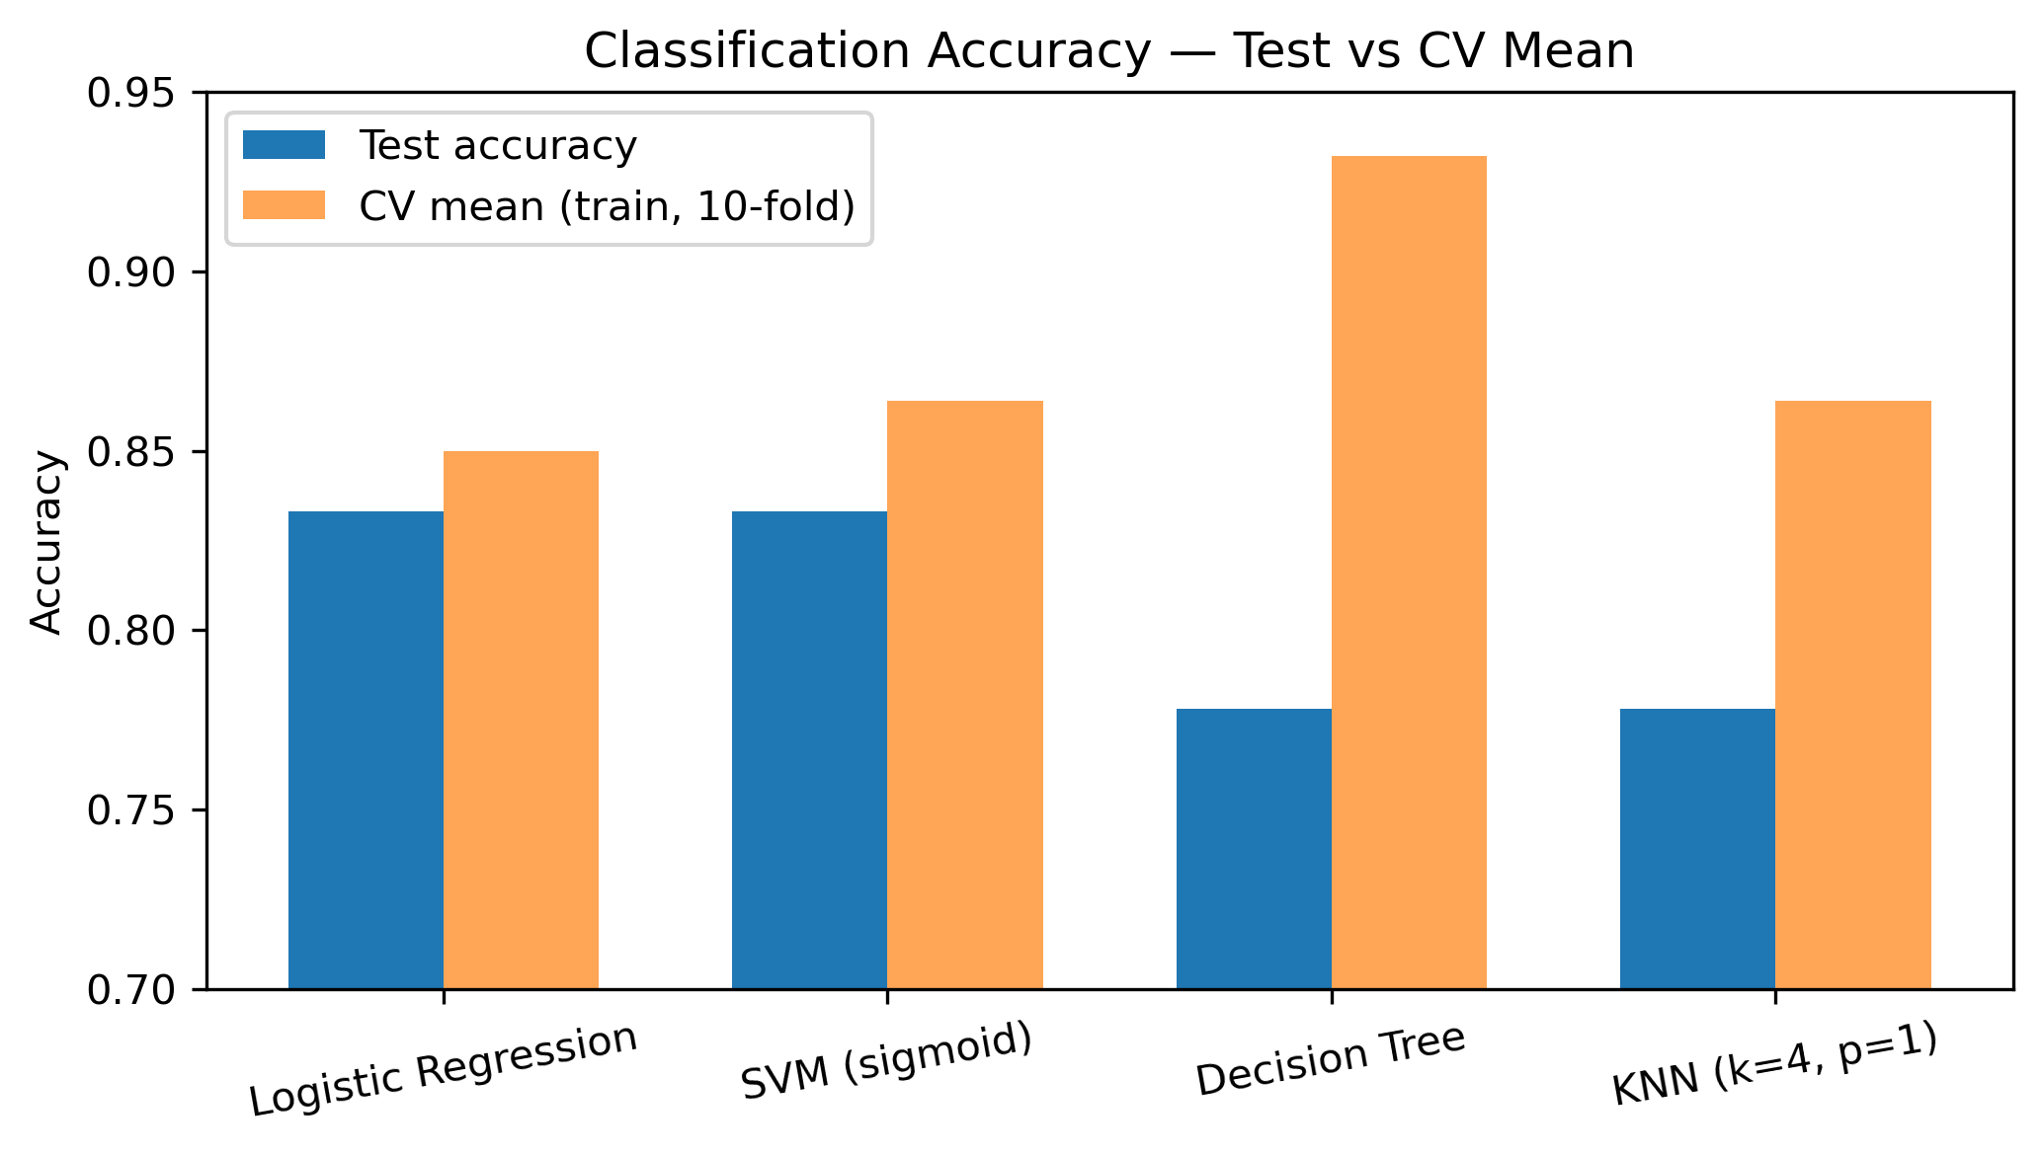
Classification Accuracy (Test vs. CV Mean)
What the chart shows:
Bar chart comparing test accuracy (blue) vs. 10-fold CV mean on training (orange) for four models: Logistic Regression, SVM (sigmoid), Decision Tree, KNN (k=4, p=1)
Numbers (test accuracy)
Logistic Regression: 0.833
SVM (sigmoid): 0.833
Decision Tree: 0.778; KNN (k=4, p=1): 0.778
Key takeaways:
Best test accuracy (tie): Logistic Regression and SVM (sigmoid), both 0.833
Decision Tree shows the highest CV mean (0.932) but drops to 0.778 on test → overfitting
KNN is the lowest performer (0.778)
Conclusion:
Select Logistic Regression or SVM (sigmoid) as the final model; both are the most reliable and consistent with EDA patterns

Slide 50
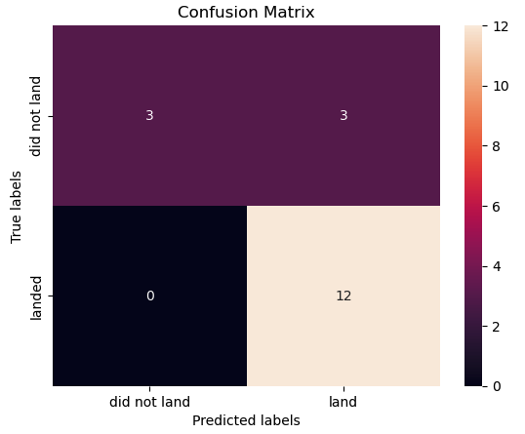
Confusion Matrix – Best Models (LR & SVM-sigmoid)
What this shows:
Rows = true labels; columns = predicted labels
Positive class = land (Class=1); negative = did not land (Class=0)
Counts:
TP = 12 (land → land)
TN = 3 (did not land → did not land)
FP = 3 (did not land → land)
FN = 0 (land → did not land)
Takeaways:
The models do not miss any landings (FN=0) — very conservative for the positive class
Errors are false alarms (3 cases predicted “land” when it didn’t), which lowers precision
Overall test accuracy ≈ 0.833, consistent with the report shown earlier
Note: small test set (n=18) — interpret with caution
Identical confusion matrix for Logistic Regression and SVM (sigmoid); both models produce the same test predictions

Slide 51
Conclusions 1
What we answered.
Using historical Falcon 9 launches (2010–2020), we identified factors associated with first-stage landing success and built a classifier to predict it
Key EDA findings.
Trend: success rates improved markedly over time.
By launch site: LC-39A led the success rate (VAFB SLC-4E close, with fewer launches)
By payload mass: the 3–6 t range showed higher success; very low/very high payloads were more mixed
By orbit: orbit type correlates with outcomes, but some categories have small sample sizes
Best models.
Logistic Regression and SVM (sigmoid) tied as top performers on the hold-out test set (accuracy = 0.833) and produced the same confusion matrix: TP = 12, TN = 3, FP = 3, FN = 0
Interpretation: the model did not miss any actual successful landings (FN = 0) at the cost of a few false alarms (FP)

Slide 52
Conclusions 2
Practical implications.
Launch site and payload mass range materially influence recovery odds; orbit helps, but be cautious with small-n categories
Limitations.
Falcon 9 only, data up to 2020
Modest sample size (~90 records; test n ≈ 18)
PayloadMass imputed with the mean
Potential inconsistencies in site labels
Missing context variables (e.g., weather/sea state)
Next steps.
Extend the time window and features (weather, sea state, mission profile); normalize site labels; calibrate probabilities and tune decision thresholds with cost-sensitive analysis; retrain and monitor with more data

Slide 53
Appendix 1
Code & artifacts.
GitHub repository with notebooks, preprocessing pipeline, Folium map, and Plotly Dash app (project repository)
Data used.
Primary sources: SpaceX REST API (v4) + Wikipedia web scraping
Modeling dataset: dataset_part_1.csv, dataset_part_2.csv, dataset_part_3.csv (≈90 rows; Falcon 9 up to 2020-11-13)
Exploration table: spacex_web_scraped.csv (web-scraped for EDA)
SQL EDA database: my_data1.db

Slide 54
Appendix 2
Notebooks/Labs (overview).
Data collection (API + scraping) and export to CSV
Data wrangling (target creation from landing outcome, one-hot encoding, imputations)
EDA & visualization (by site, payload range, orbit, annual trend)
EDA in SQL (aggregations, filters, temporal slices)
Geospatial analysis with Folium (launch sites and distances)
Interactive dashboard with Plotly Dash (success ratios and payload-vs-class scatter)
Supervised classification (LR, SVM, Decision Tree, KNN) with GridSearchCV and standardized features
Representative SQL queries shown.
Unique sites and CCAFS filters; payload-mass sums/means by customer/booster; first ground-pad success date; drone-ship success for 4–6 t; success vs failure counts; max payload by booster; monthly failures in 2015; ranking of landing outcomes (2010–2017 window)

Slide 55
Appendix 3
Reproducibility notes.
Pipeline: API → enrichment/filtering (Falcon 9) → payload mass imputation (mean) → one-hot encoding → standardization (for linear models) → stratified 80/20 train/test split → GridSearchCV → evaluation (accuracy, confusion matrix, classification report)
Environment: Python 3.x; pandas, scikit-learn, plotly, folium
Acknowledgments.
SpaceX REST API, Wikipedia contributors, IBM Applied Data Science Capstone template

Slide 56


